Slide 1
DELE CA2
Isaac Low Pxxxxxx
Siang Yu P2342546

Slide 2
PART A: GAN

Slide 3
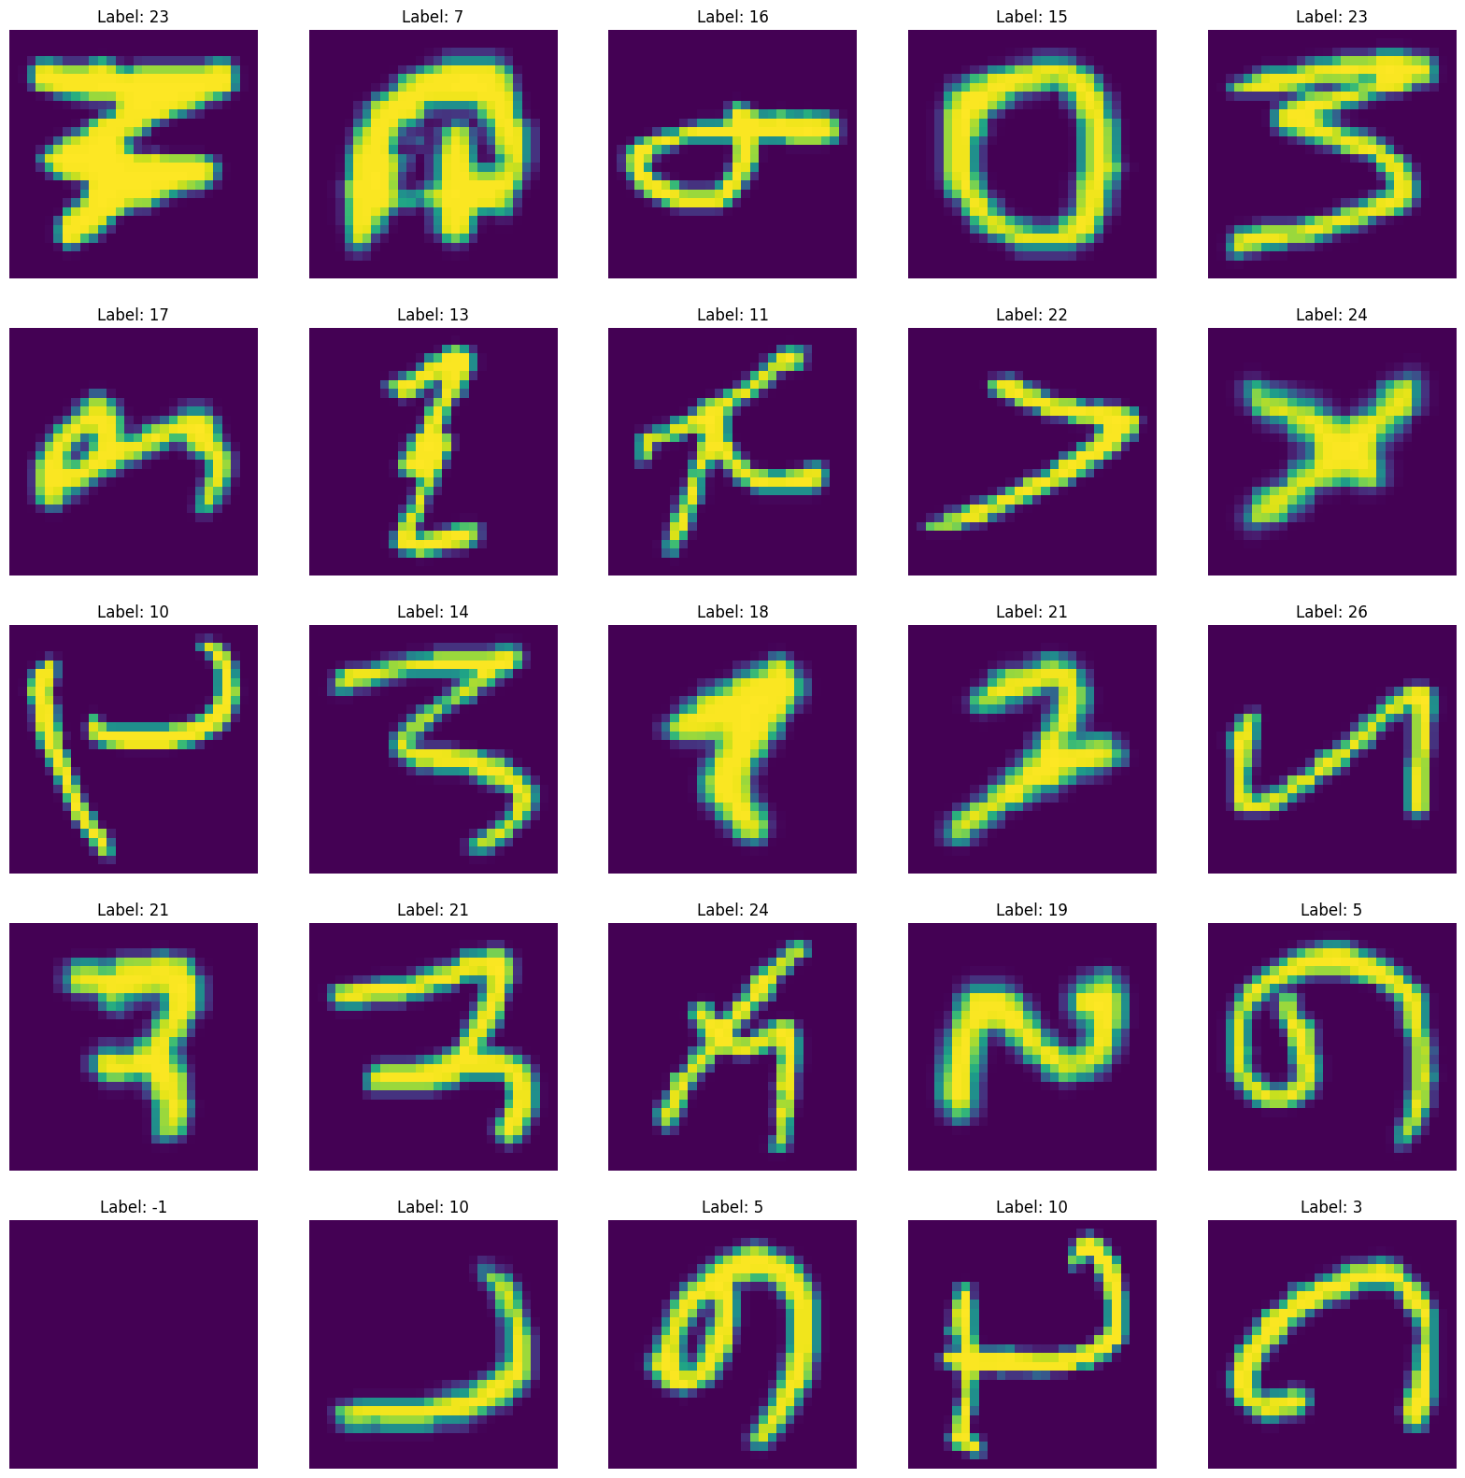
EDA and feature engineering
Importing the data and displaying it we see that the images scarcely resemble letters, so we performed some transformations to make it look correct.
We also see that it is in full color so we will transform it into black and white
We can also see that label -1 is empty and we have checked the rest of the class and it is empty so we will not bee saving all class -1s

Slide 4
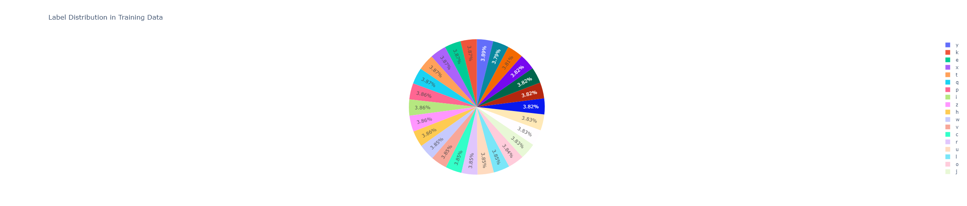
EDA and feature engineering
Here we can se the distribution of different classes of alphabets in the dataset and we can tell that it is fairly balanced which is a good thing as it means that all the letters would be represented in the model

Slide 5
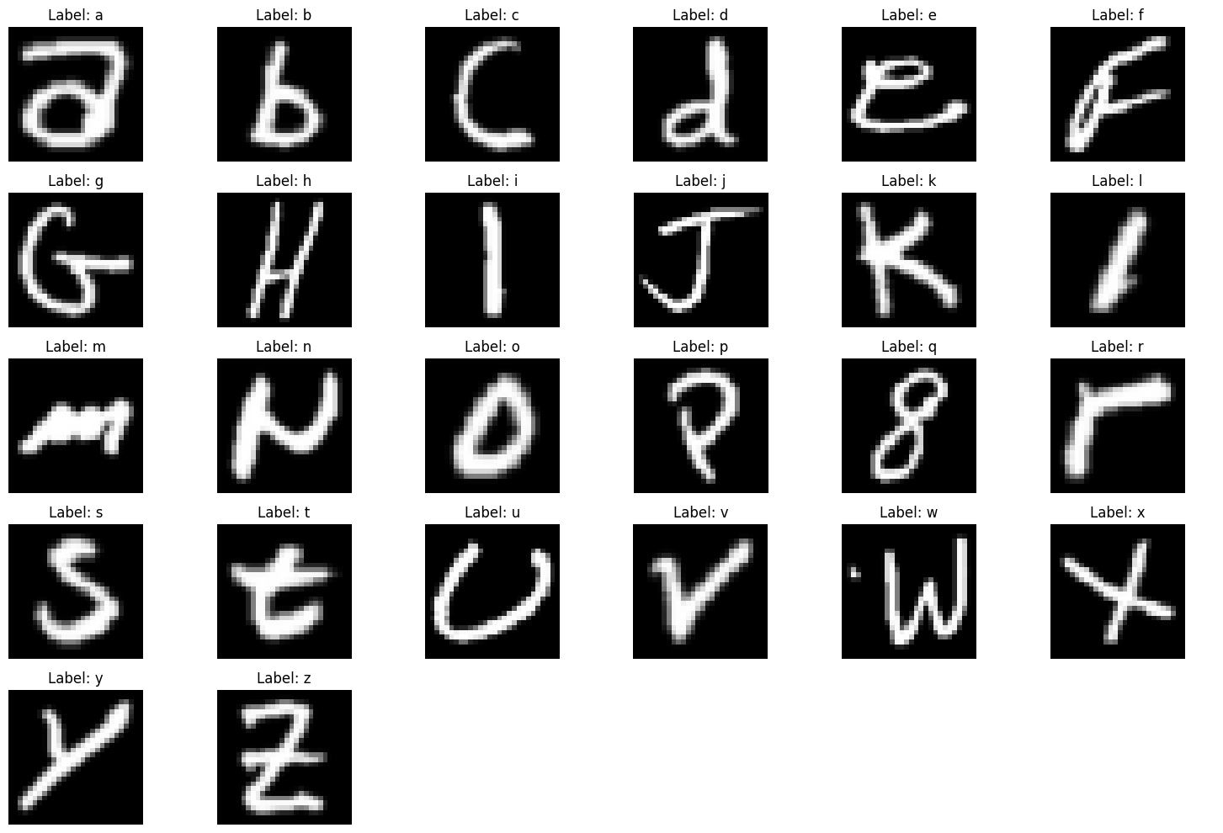
Final save of the images one of each class
Here we can see that the images are a mixture of upper and lower case and that the images displayed correspond to the labels and it is oriented the right direction and also in black and white

Slide 6
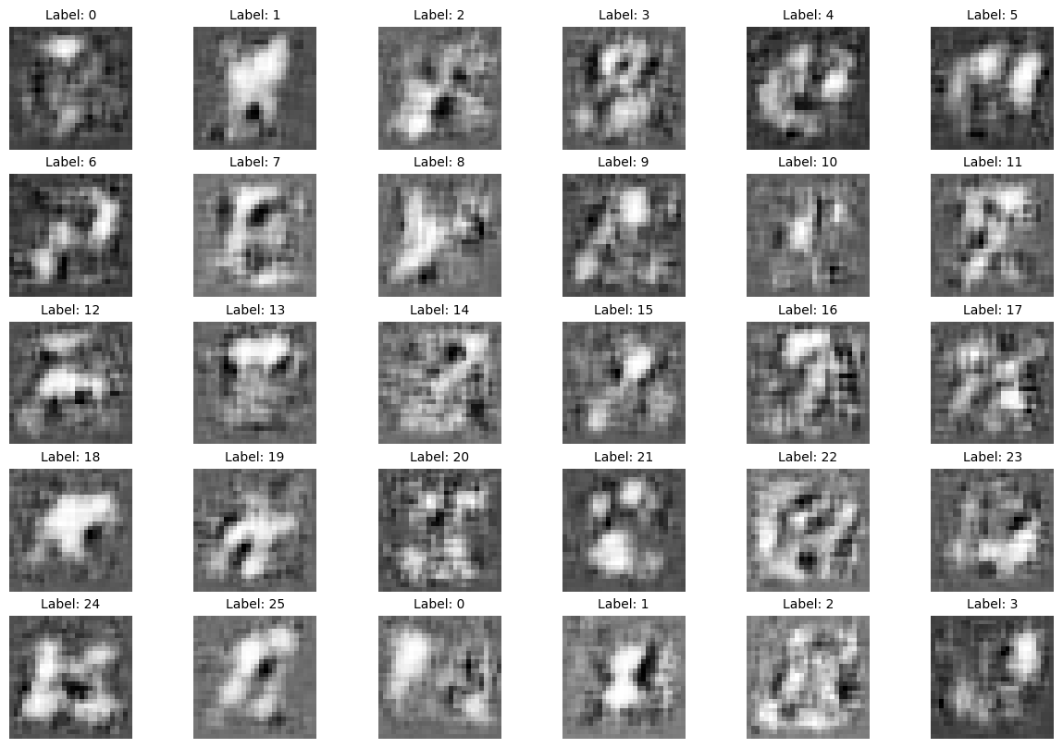
Application of cGAN
Here we can see from the application of the cGAN, the images produced are very noisy and do not resemble any letters at all

Slide 7
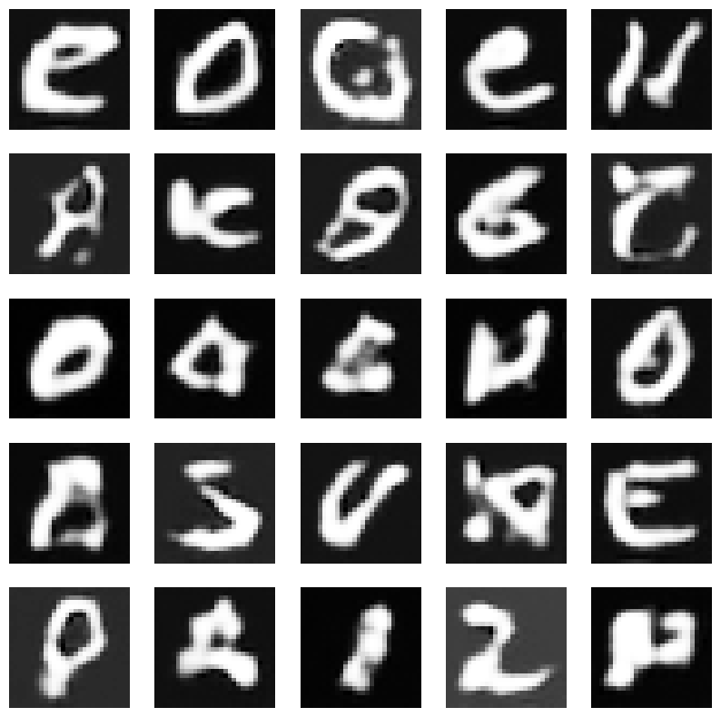
Application of DCGAN
After 4 epochs and around 3000 steps, we get images that look like these. If we were to do a by-eye analysis, there would be 12 clear, 4 rubbish and 9 marginally good images in this 5x5 grid sample.
I have also used metrics to try and get a better understanding and the results are a
Frechet Inception Distance: 941731.0745
Kernel Inception Distance:
-144.3394
This is an extremely high number and the kernel inception distance isn’t supposed to be negative. This might mean that the scores do not accurately capture the model’s performance.

Slide 8
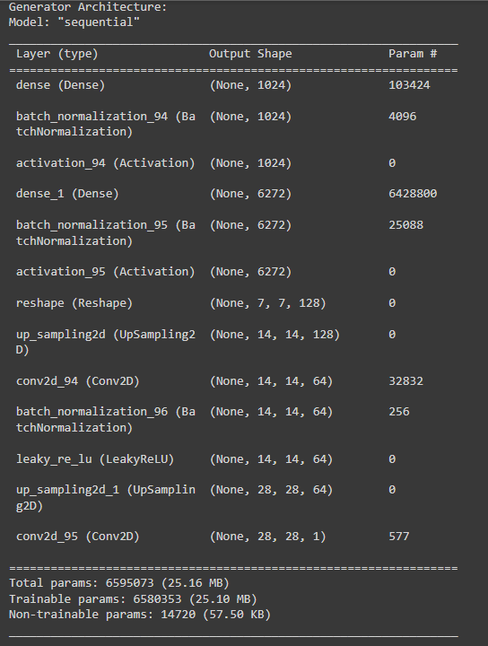
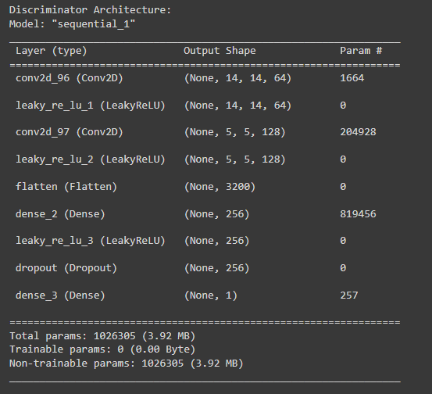
Explanation of the generator and discriminator architecture
Generator Architecture
Dense Layers:
Initial layer with 1024 units, followed by a 6272-unit layer to expand the noise vector.
Batch Normalization:
Applied after each dense layer (momentum 0.8).
Activation:
ReLU after dense layers.
Reshape Layer:
Converts output to (7, 7, 128).
UpSampling2D:
Upsamples image to 14x14, then 28x28.
Conv2D Layers:
First with 64 filters (2x2), final with 1 filter (3x3) and tanh activation.
Discriminator Architecture
Conv2D Layers:
Initial with 64 filters (5x5, strides 2), followed by 128 filters.
LeakyReLU Activation:
Applied after each convolutional layer (alpha 0.2).
Flatten:
Converts 3D tensor to 1D.
Dense Layer:
256 units, followed by dropout (0.5).
Final Dense Layer:
1 unit with sigmoid activation.
Compilation
Loss Function:
Binary cross-entropy.
Optimizer:
Disc optimizer.
Metrics:
Accuracy.

Slide 9
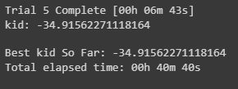
Tuning and model improvement
We used Keras tuner random search to tune the model, on the Kernel inception distance score. Even though the score is negative which it isn’t supposed to be, we managed to reduce the score greatly such that it went from negative a few thousand to -34.9 which is a great improvement.

Slide 10
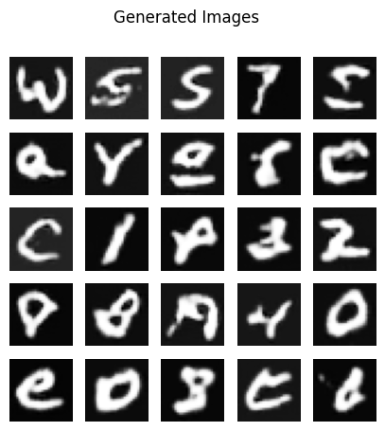
Final model train and evaluation
This is the final output of the model after training for 20 epochs on the best weights that we discovered from the keras tuner. It has 17 good images, 5 garbage images and 3 marginal image which is a great improvement from before. the loss of this final model is at 0.19 discriminator loss and 0.00935 generator loss which is fairly good as well. The Kid is -37.5 as before

Slide 11
PART B: REINFORCEMENT LEARNING

Slide 12
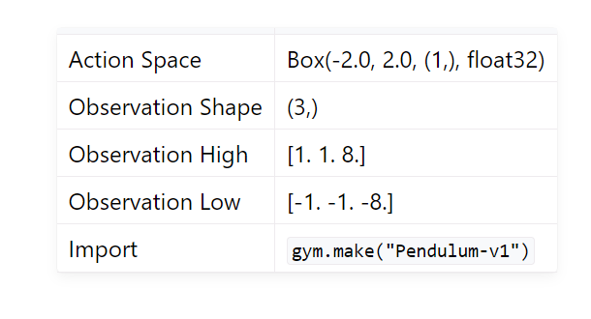
Pendulum (open AI gym)
Pendulum has a continuous action space from -2.0 to 2.0
Observation shape of 3, a discrete value

Slide 13
DQN
Q-Learning: DQN uses the Q-learning algorithm, which estimates the optimal action-value function (Q-function) that maps states to expected future rewards.
Experience Replay: Experience replay decorrelates the sequential experiences by storing them in a replay memory buffer. This memory buffer is randomly sampled to break dependencies, overfitting and stabilize learning.

Slide 14
DQN for Pendulum
The pendulum has a continuous action space. the DQN would need to handle an infinite number of possible actions, which is impractical for direct Q-value estimation.
Thus, there is a need to discretize the action space to simplify the process of selecting the action with the highest Q-value or exploring other actions.
But, discretizing a continuous action space leads to a loss of precision as it limits space to a finite set. This can result in suboptimal performance if the chosen discrete actions cannot closely approximate the best continuous action.

Slide 15
Hyperparameter(epsilon)
In Deep Q-Networks (DQN), the concepts of epsilon and epsilon decay play crucial roles. A high epsilon value(close to 1) means the agent will explore more by taking random actions, which can slow down the learning process due to excessive randomness. Conversely, a low epsilon value(close to 0) results in the agent relying more on its learned policy, which can hinder the discovery of optimal strategies due to its increased conservatism.

Slide 16
Hyperparameter(epsilon decay)
Epsilon decay is crucial for balancing exploration and exploitation in training. Initially, epsilon is set to 1.0, promoting fully random actions to ensure the agent explores the action space broadly and gains diverse experiences. With each episode, epsilon decays (e.g., at a rate of 0.995), gradually reducing the amount of randomness. As epsilon decreases, the agent increasingly relies on its learned policy to choose actions, focusing more on exploiting the knowledge it has gained to maximize rewards and refine its decision-making towards optimal strategies.

Slide 17
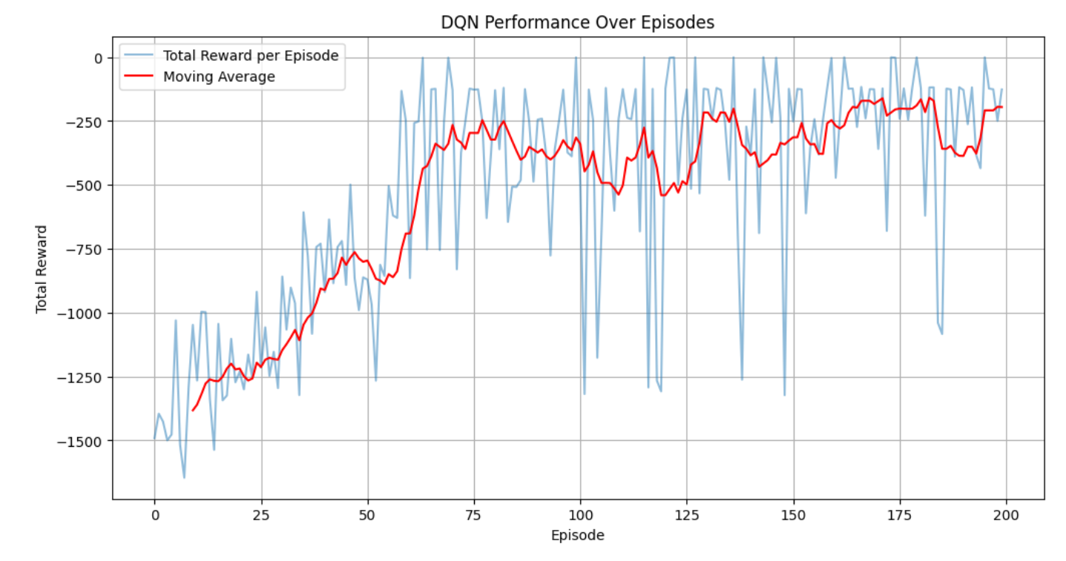
DQN Performance
The total reward per episode shows a clear upward trend.
Large fluctuations in total rewards per episode is due to random actions taken due to epsilon.
Moving average smooths out these fluctuations, revealing a more consistent improvement trend.
Increasing the number of episodes would have no significant improvements on the DQN due to flattening graph.

Slide 18
Thank You!

